Slide 1
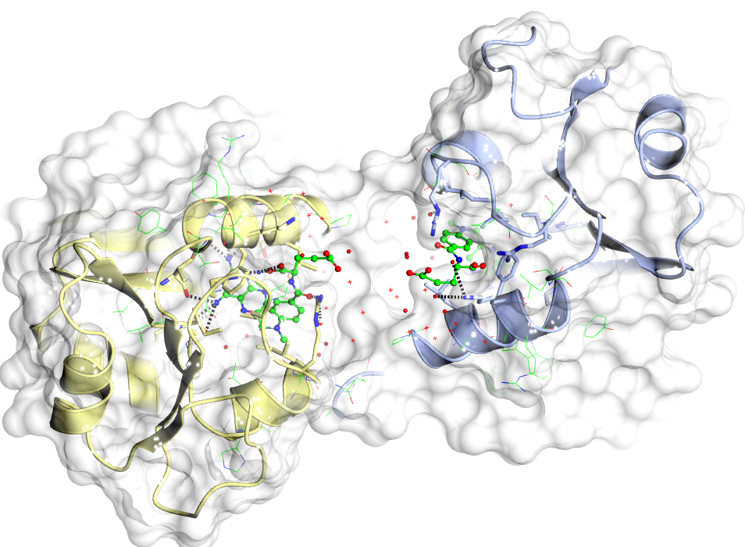
CCP4MG
Diamond/CCP4 workshop 2022

Slide 2
Introduction
CCP4MG is a molecular graphics program funded by CCP4.
Its primary focus is the visualization and analysis of macromolecular structure.
It produces high quality rendered images and movies.
http://legacy.ccp4.ac.uk/MG/
  Binaries for Windows, Mac and Linux.

Slide 3
Displaying Molecules (styles)
CCP4MG can display molecules in many different ways:
  Bonds, cylinders, ball and stick, spheres
  CA traces
  Thermal ellipsoids
  Ribbons, worms, etc.
  Base pair “sticks”, base blocks
  Lipid cartoons
  Surfaces

Slide 4
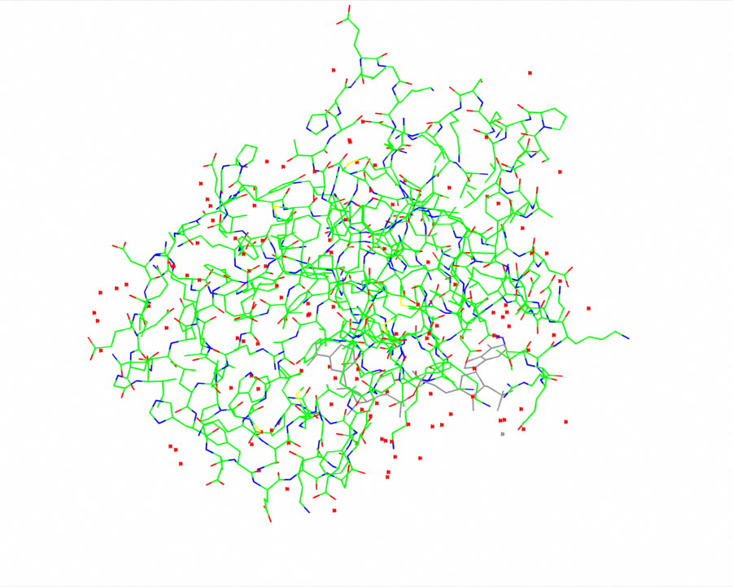
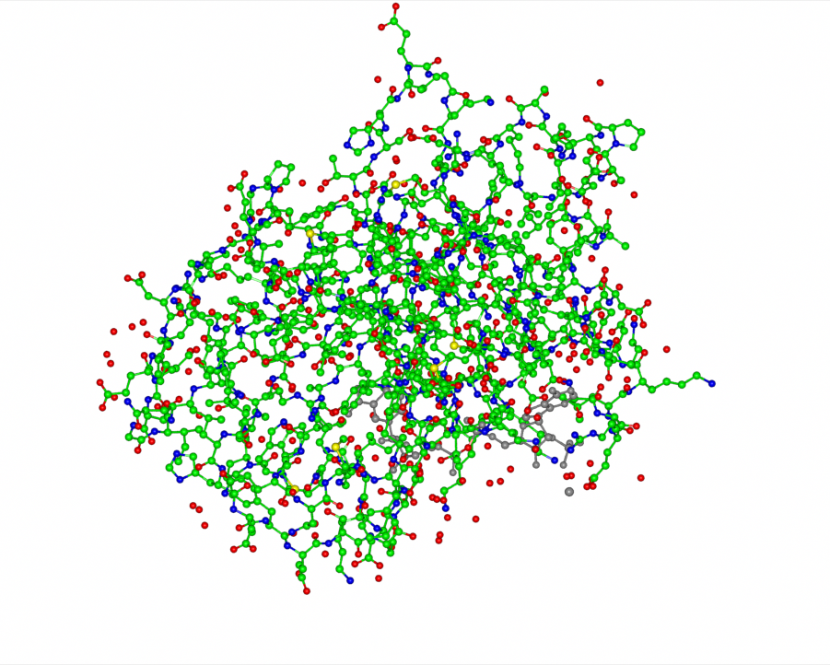
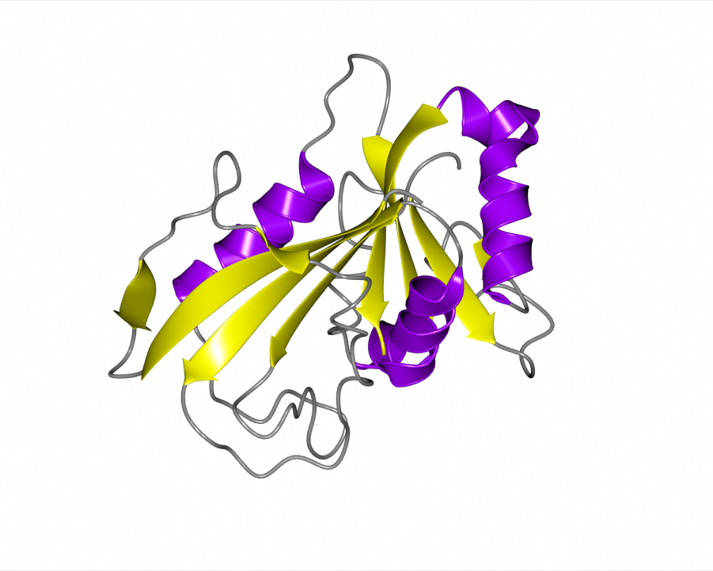
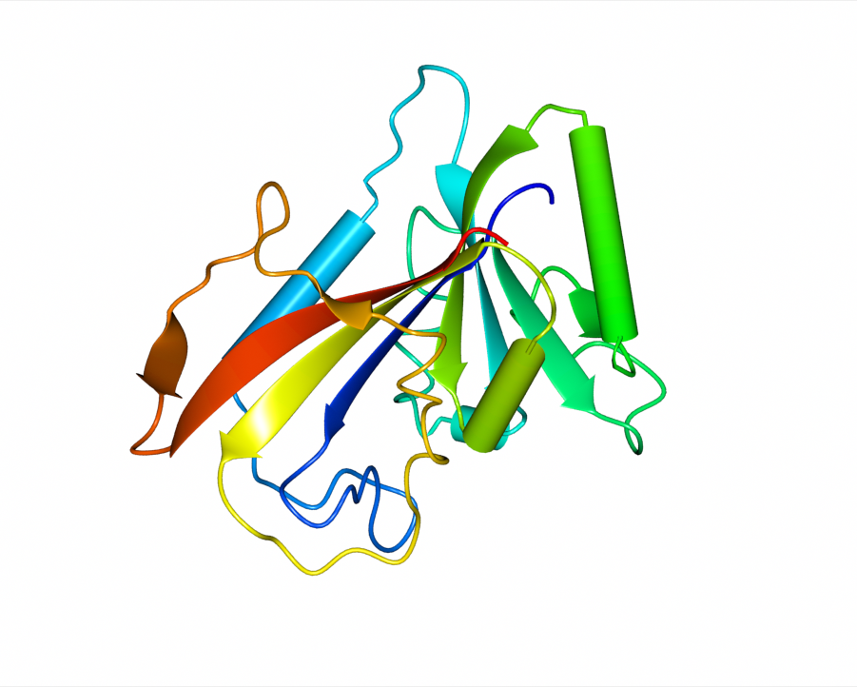
“Bonds”
“Ball and stick”
“Ribbons”
“Worms/tubes”

Slide 5
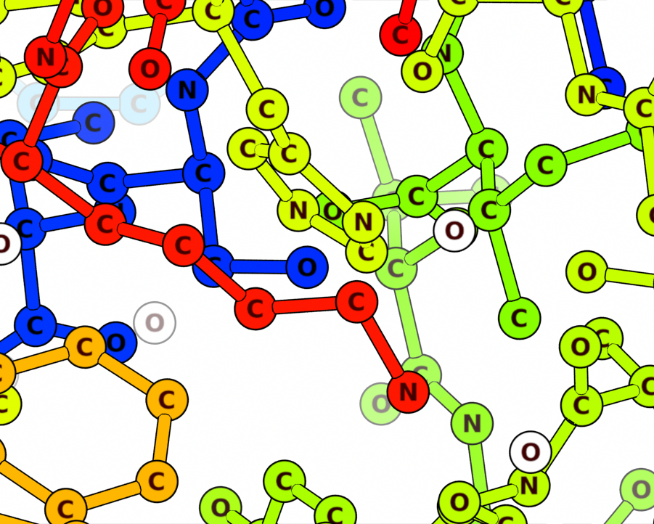
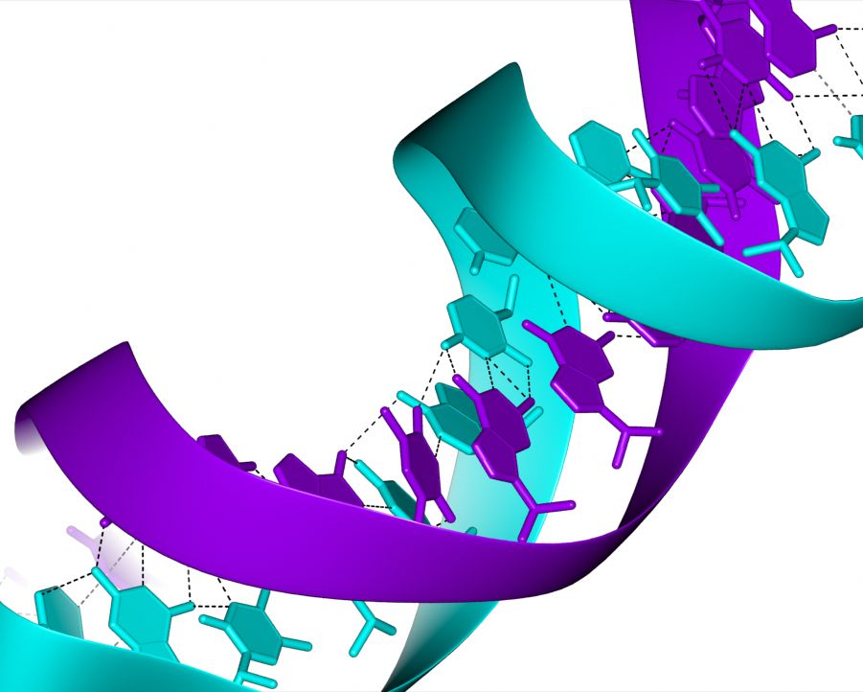
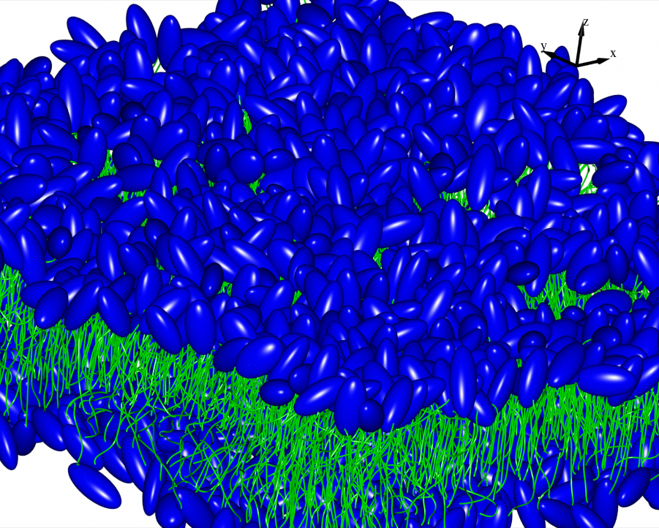
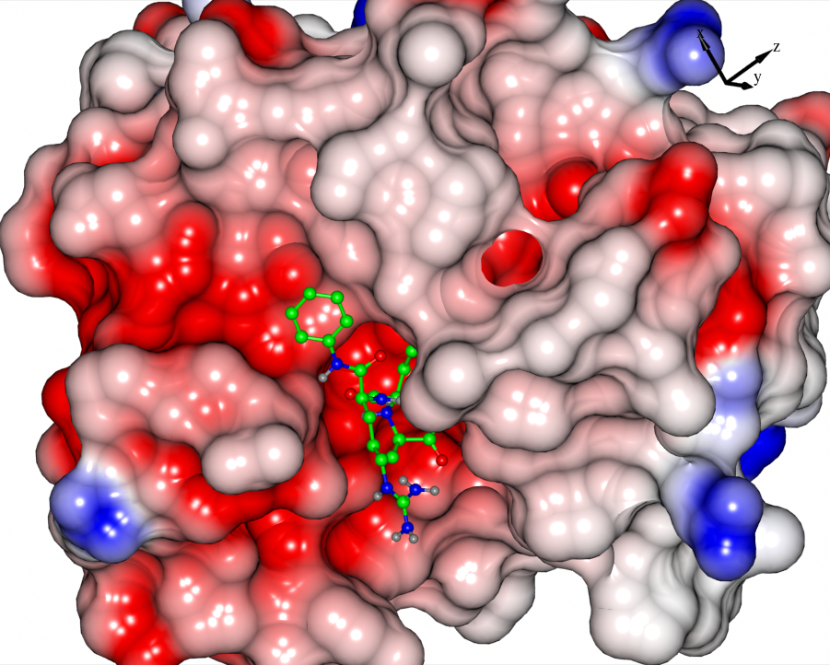
“Ribbons”
Nucleic acids
“Circles”
“Lipid Cartoon”
Electrostatic surface

Slide 6
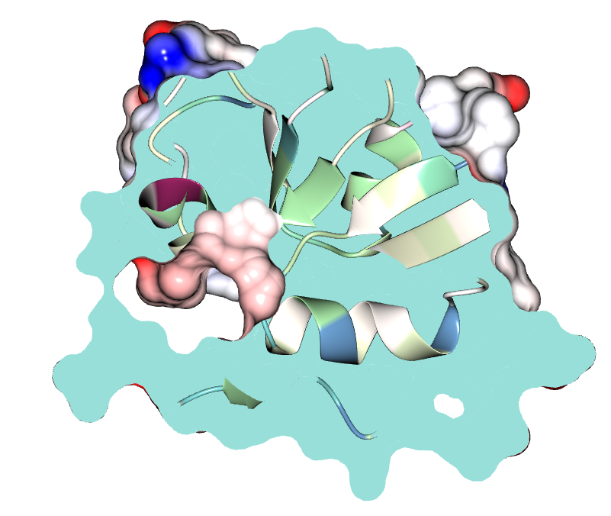
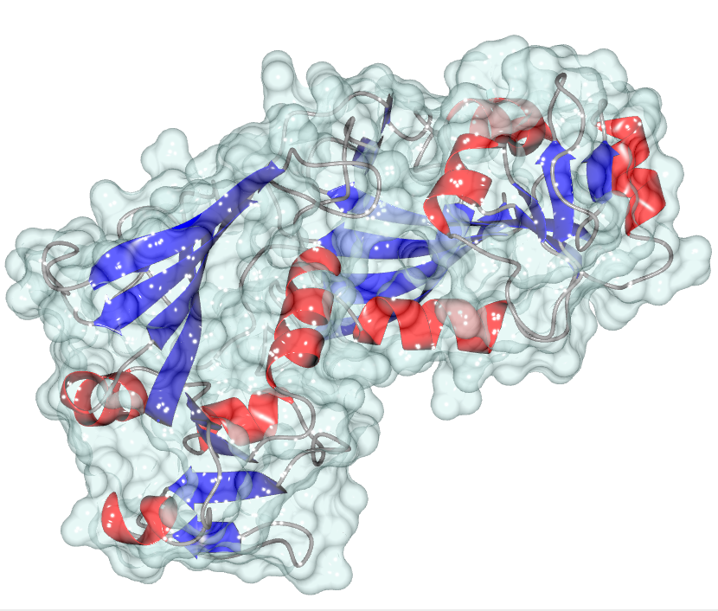
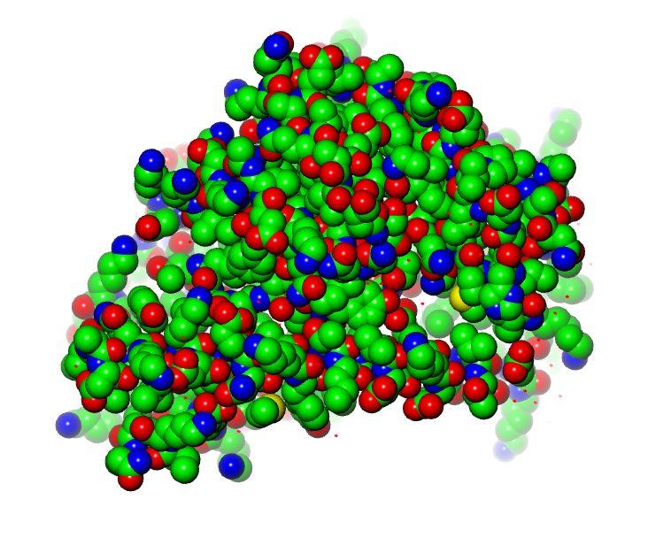
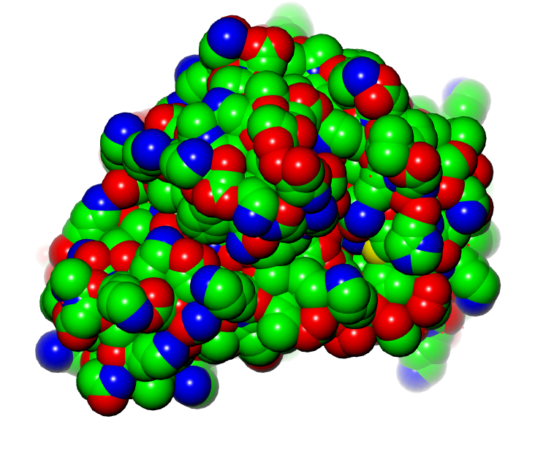
Transparent
Van der Waals
Solvent accessible

Slide 7
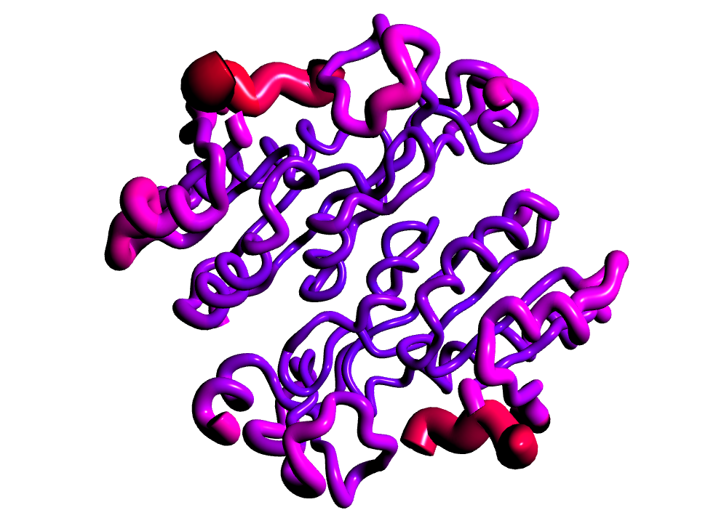
Worm scaled by B-factor

Slide 8
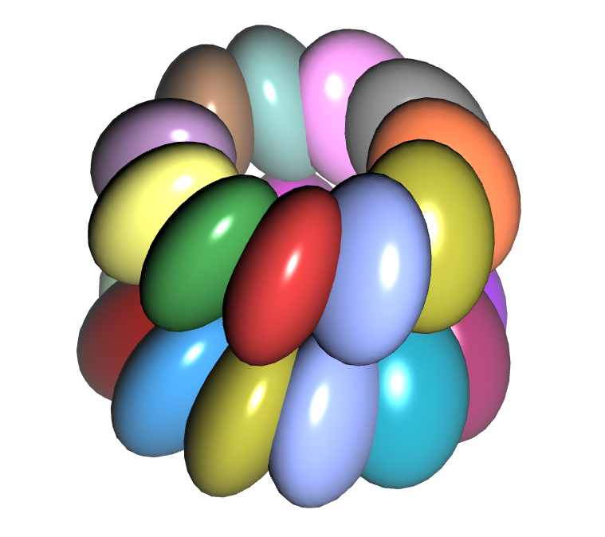
Bloboids

Slide 9
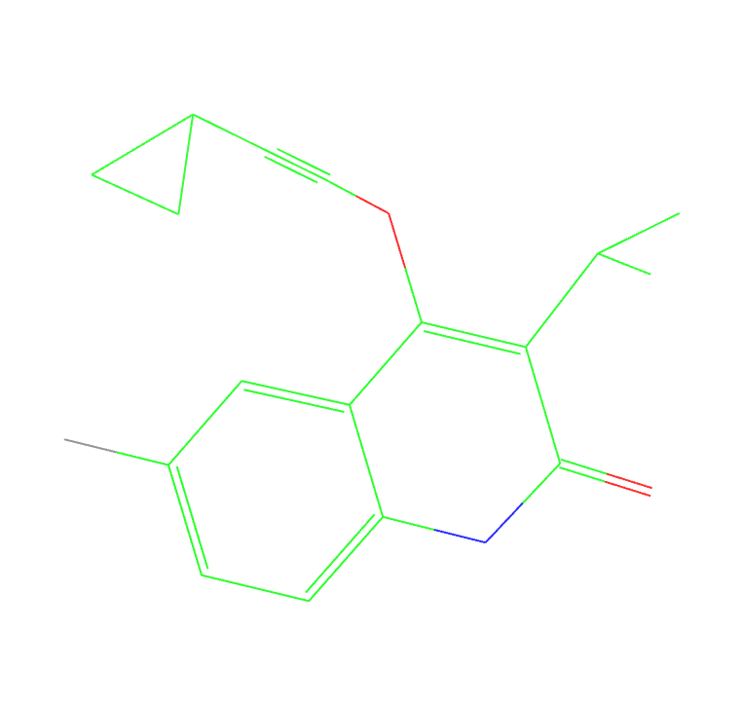
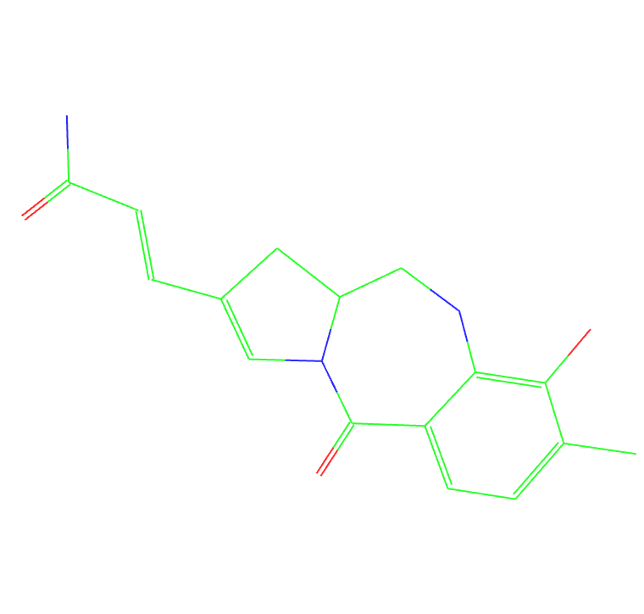
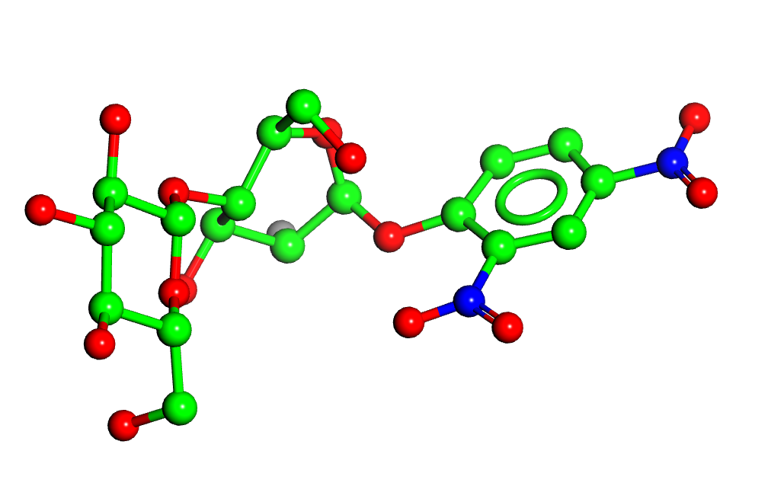
Multiple bonds
GWB (1tkx)
ANT (274d)
DCB (4a3h)

Slide 10
The program interface (introduction)

Slide 11
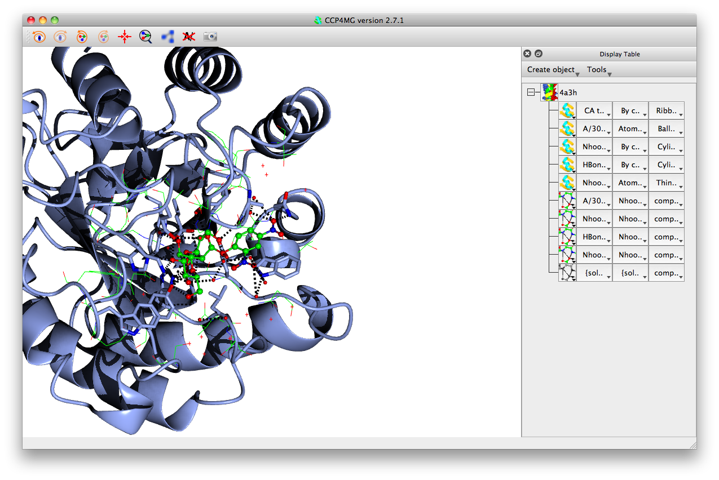
Drawing style
Colour
Atom selection
Data object
Display object

Slide 12
Atom Selections
Simple atom selections may be made with menu entries:
  All atoms, all peptide, ligands, ligand neighbourhoods, etc.
Arbitrarily complicated selections may be made using the “Selection browser”:
  Neighbourhoods of various atoms
  Atom types, residue types
  Residue ranges
  Secondary structure elements
  Individual atoms
  Logical and/or/not of all the above

Slide 13
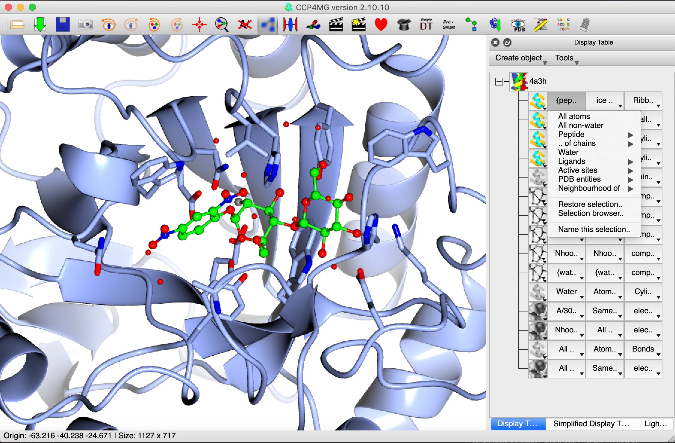

Slide 14
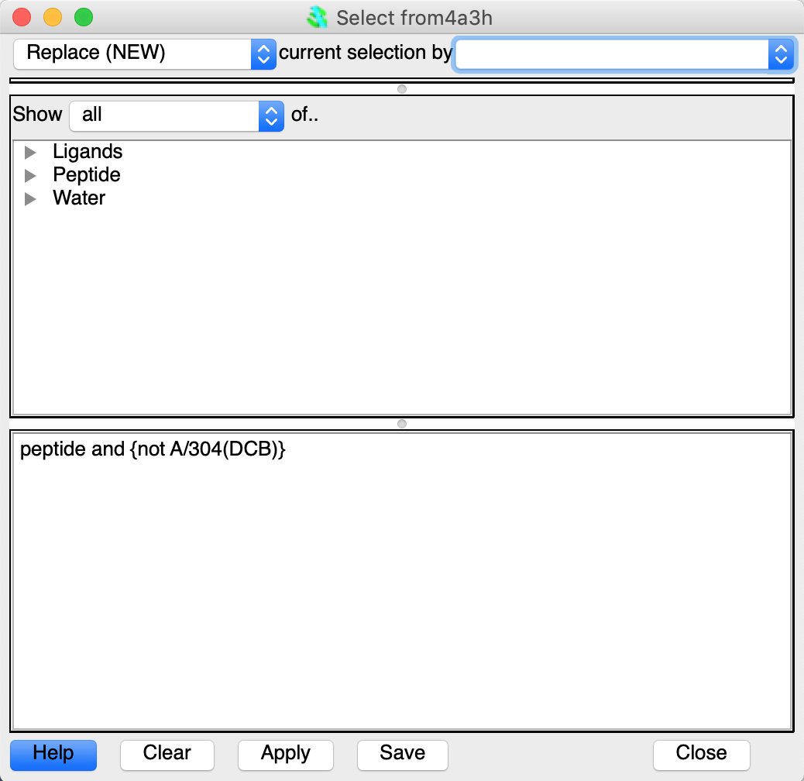

Slide 15
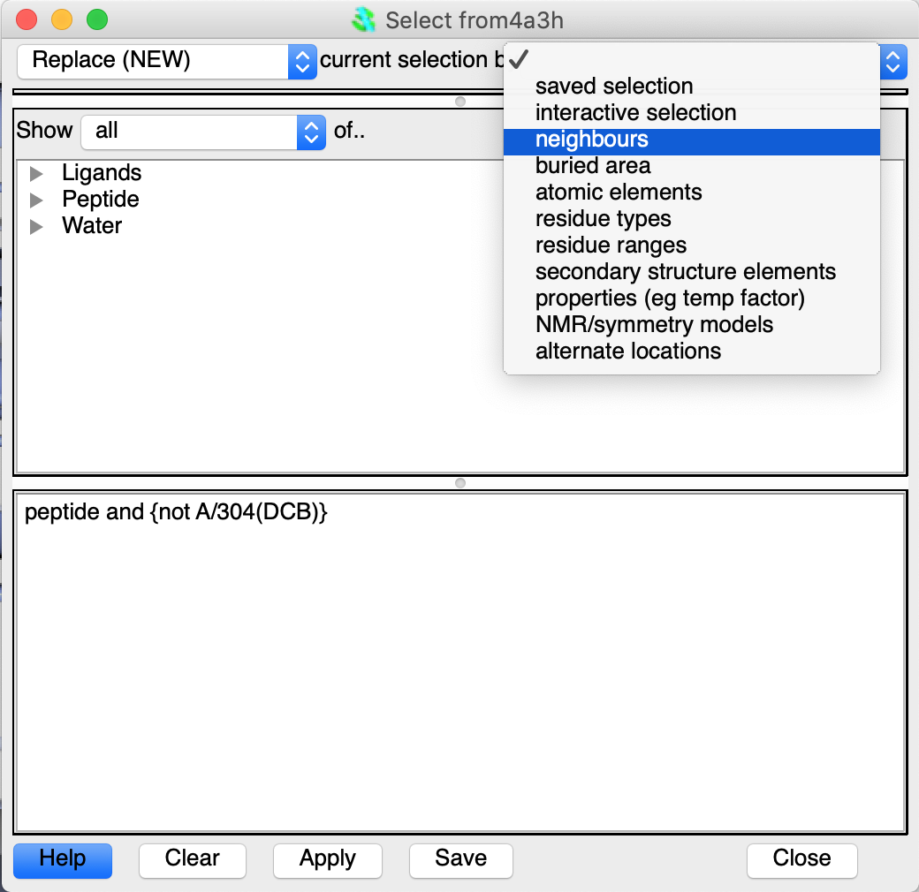

Slide 16
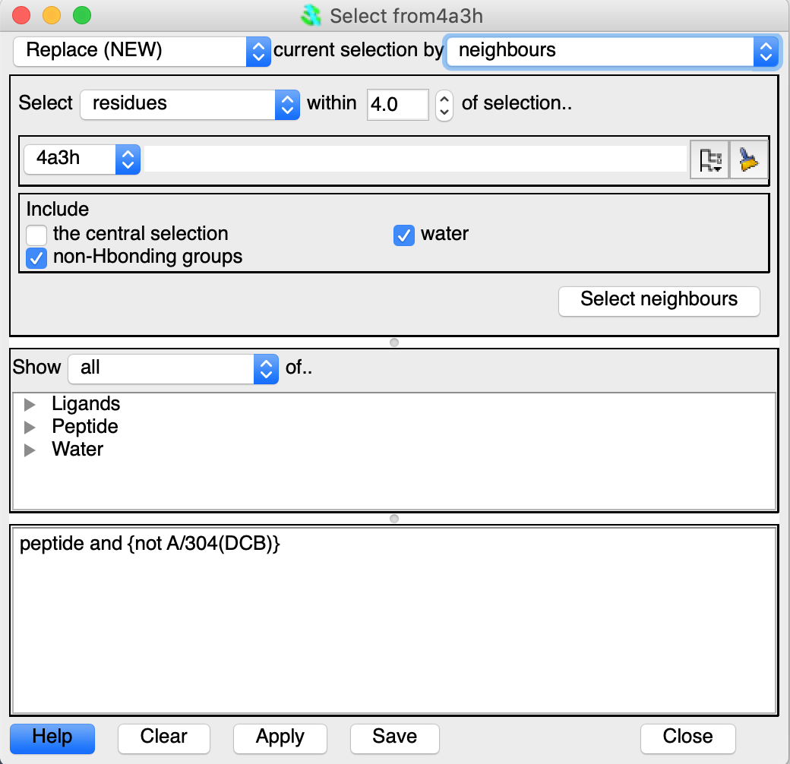

Slide 17
Picture Wizard
The picture wizard is an automatic way of generating complex scenes with multiple selections, colouring, styles, etc.
Representations are organised into various “styles”
The picture wizard is shown at the top of the file browser window when a coordinate file is loaded, or can be accessed from the display table.

Slide 18
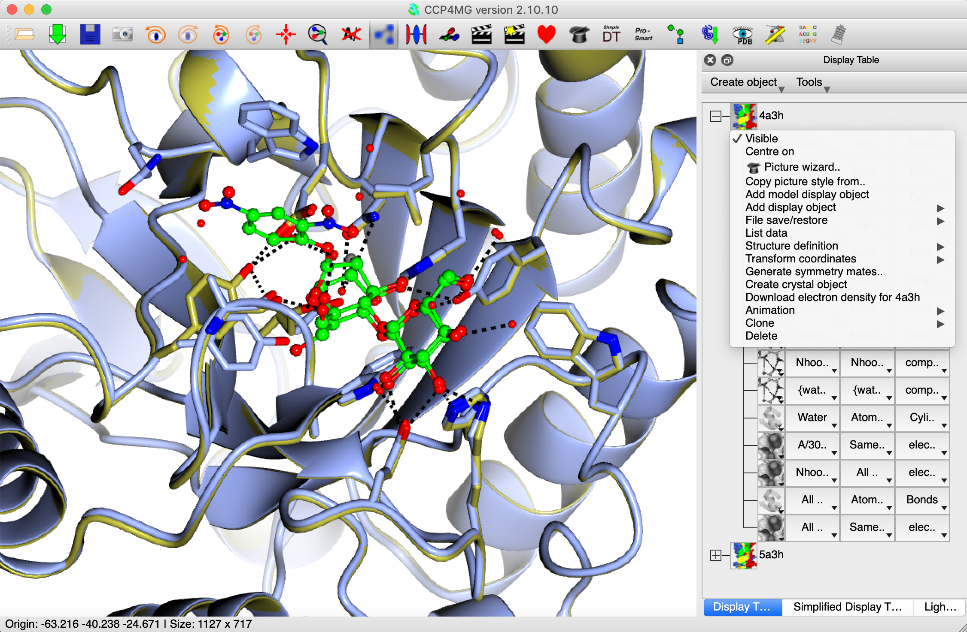

Slide 19
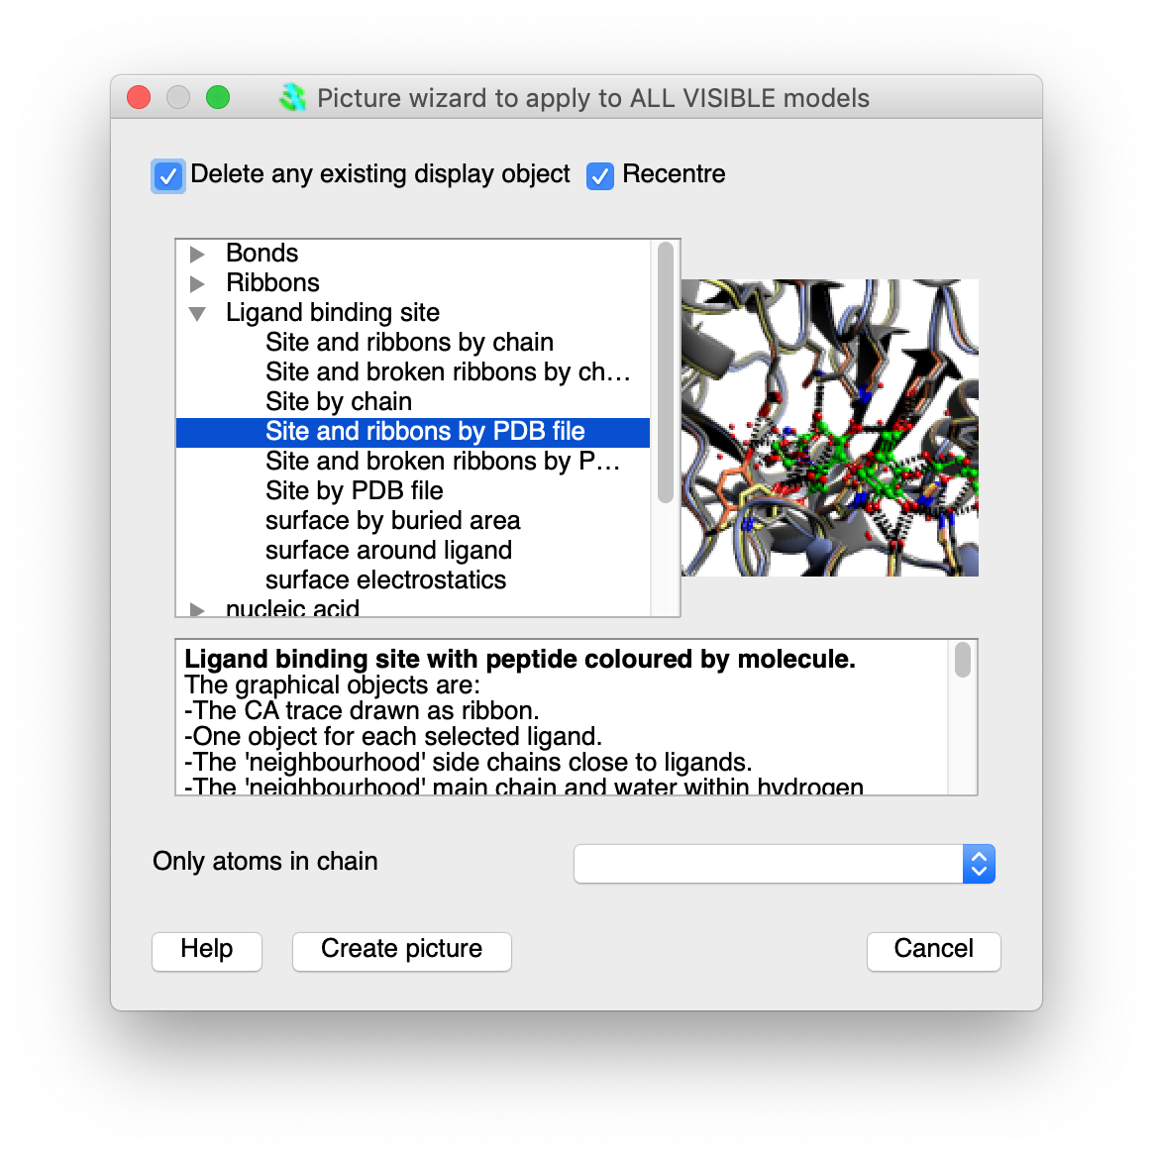

Slide 20
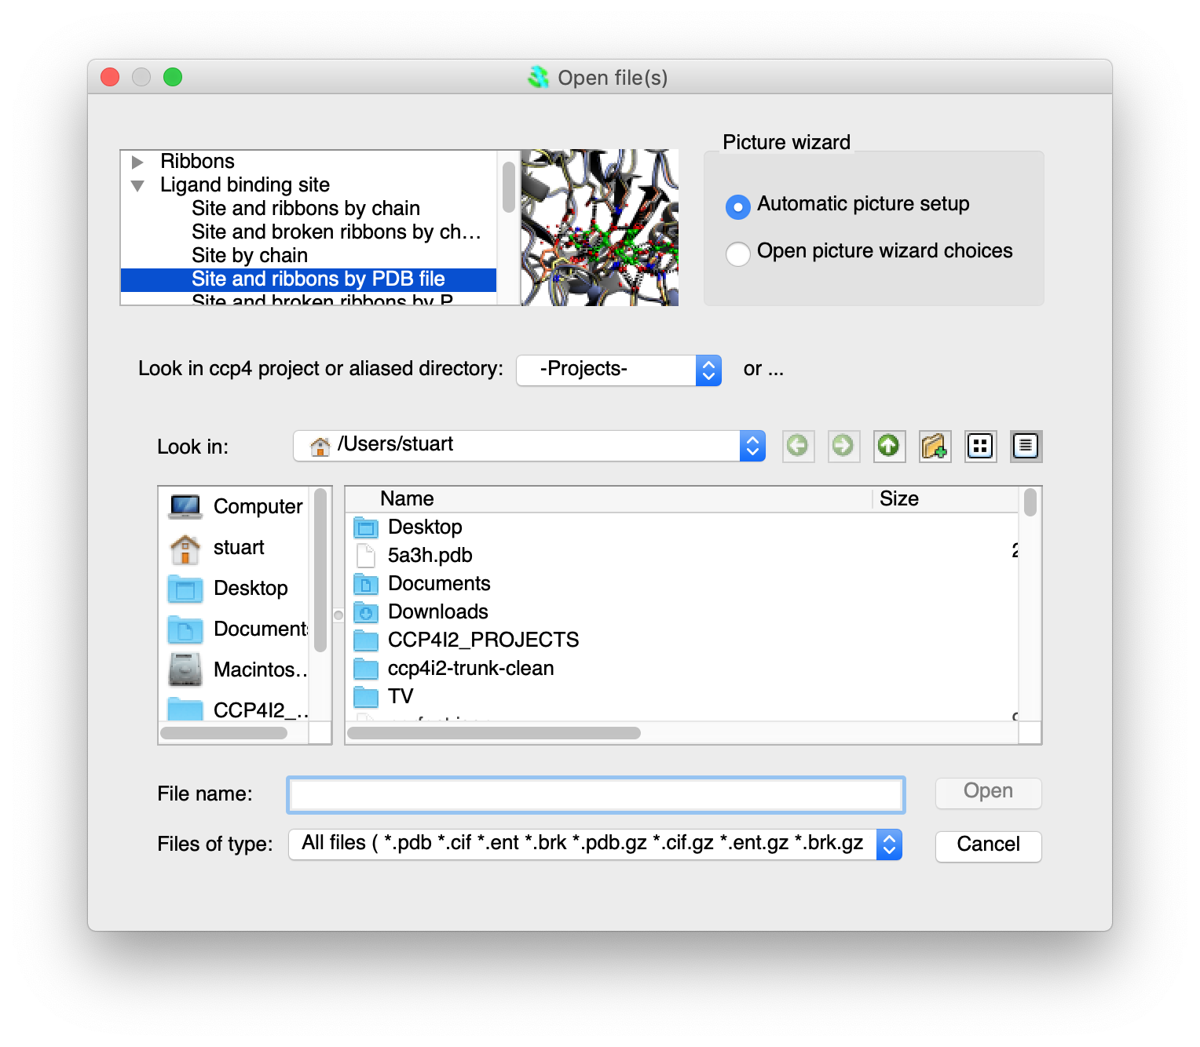

Slide 21
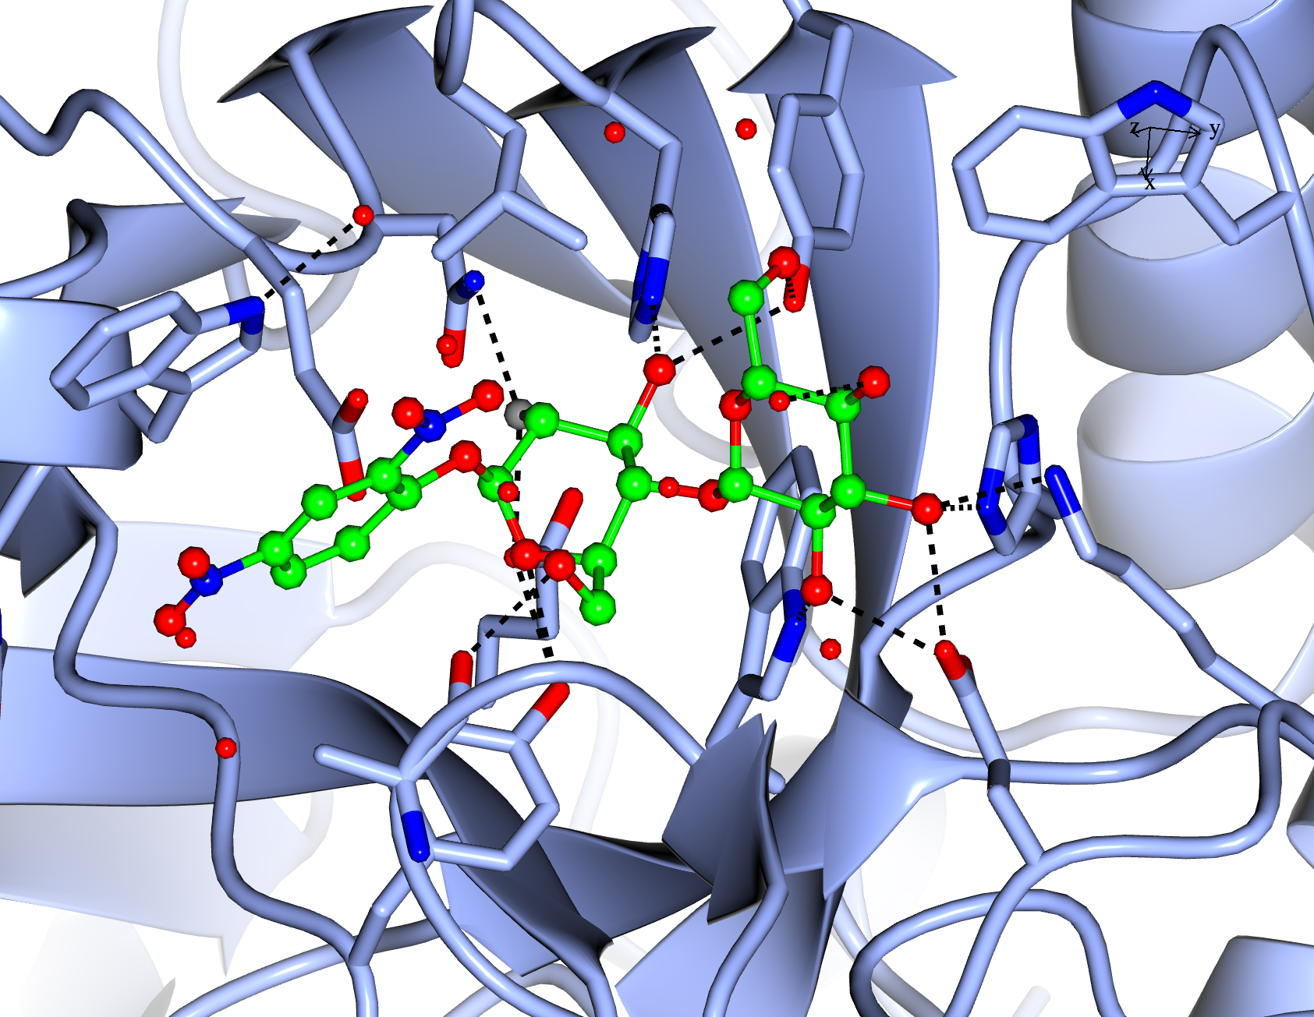

Slide 22
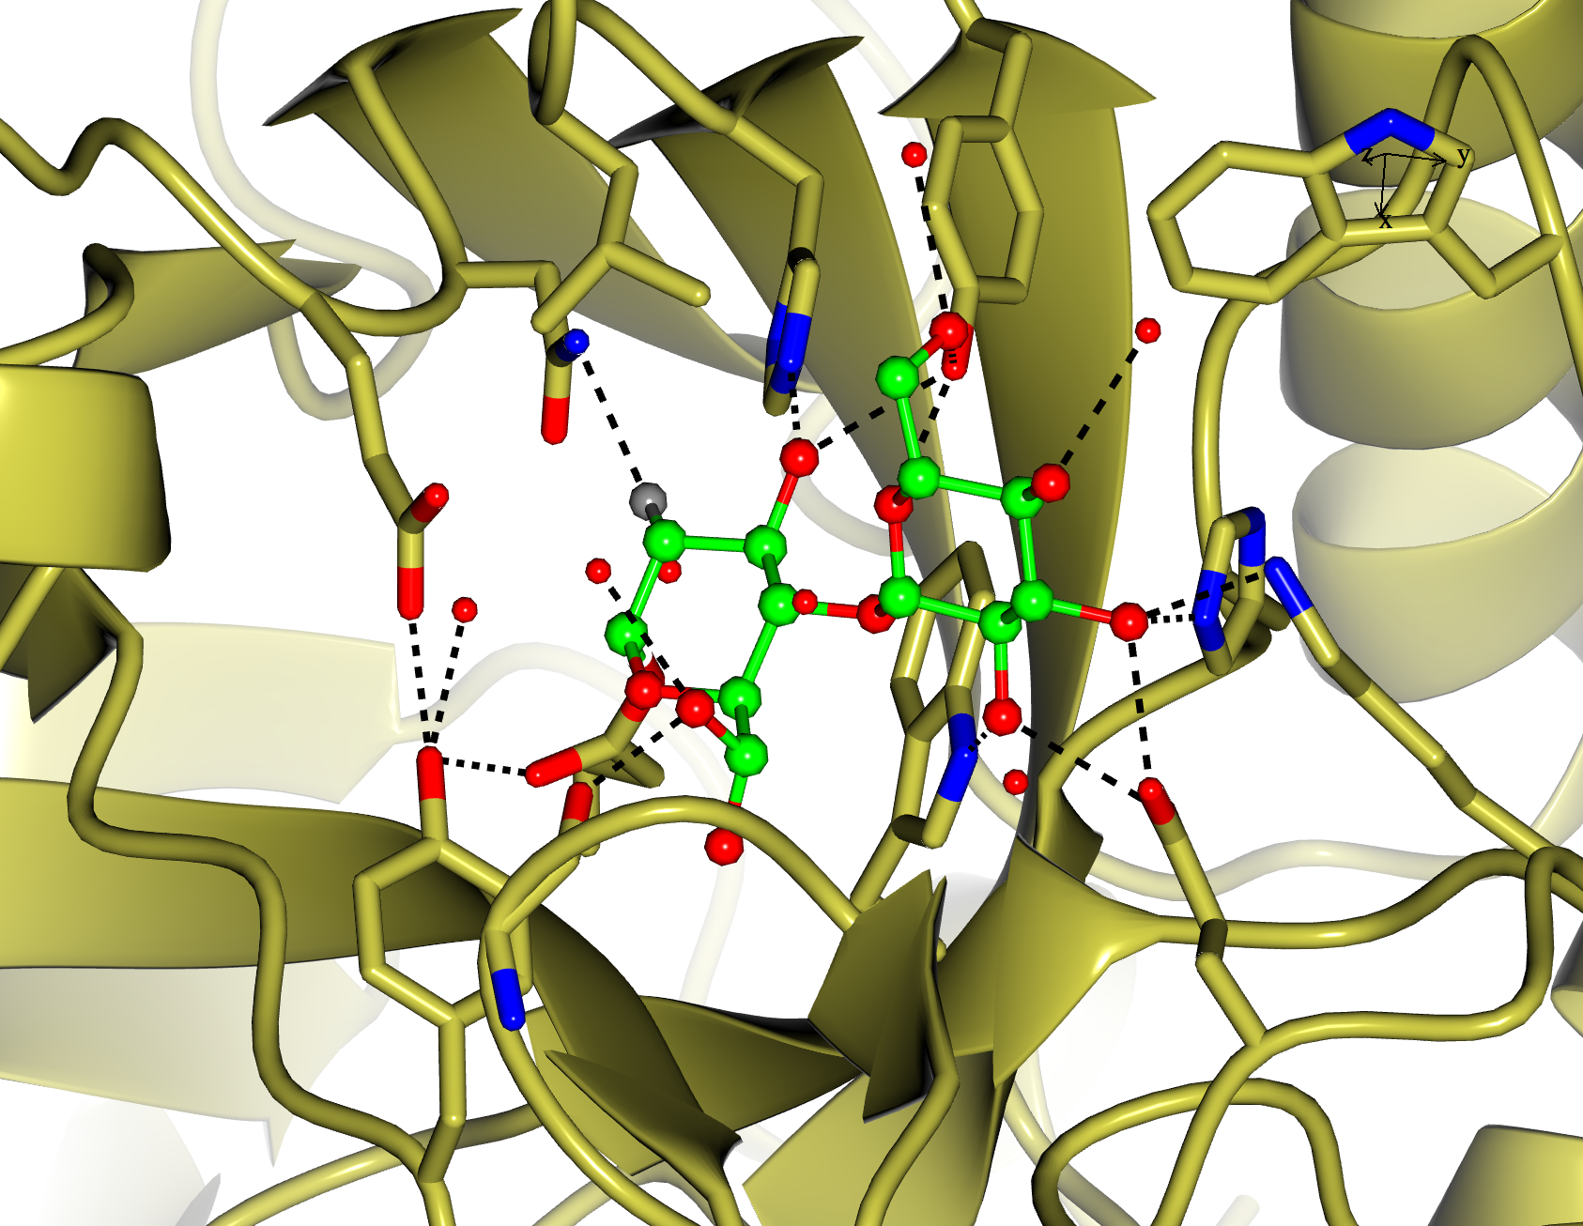

Slide 23
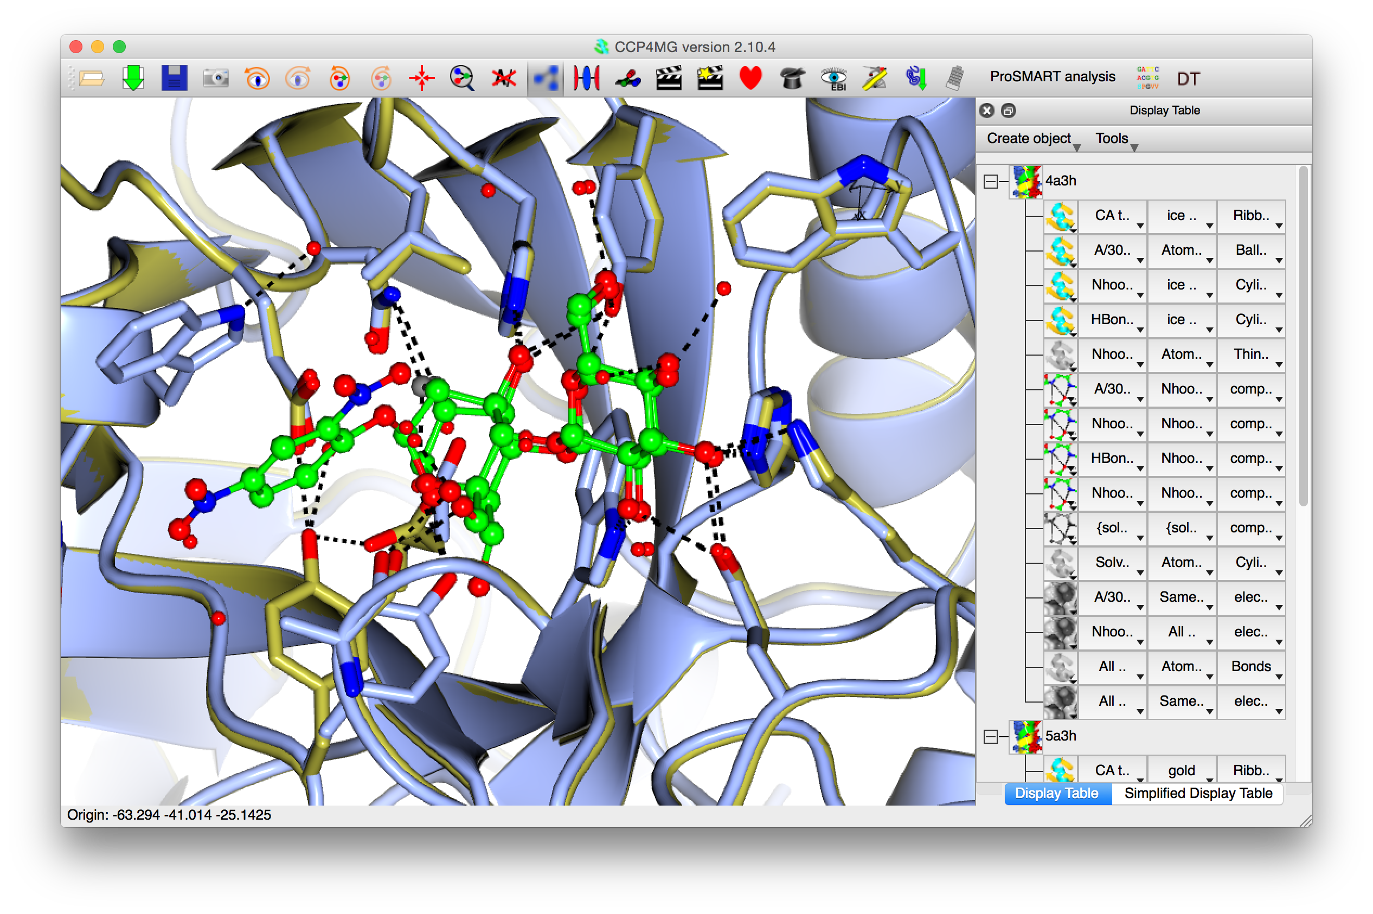

Slide 24
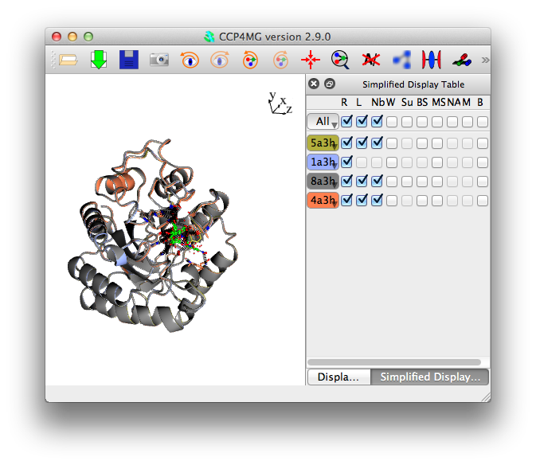
Simplified Display Table
Tool for quickly turning on/off lots of related display objects. Particularly useful for looking at large numbers of similar files. (Not a replacement for "full" Display Table, but a useful alternative for some use cases).

Slide 25
Electron Density
Electron density maps can be read/created from any CCP4 supported file format, downloaded from PDB or generated from structure factors.
Density can be represented as chickenwire lines, chickenwire cylinders, solid surface or dots.
By default a 10Å parallelepiped of density at centre of screen is drawn, this size may be changed by user. The density is recalculated and redrawn when the viewpoint changes
The density can be clipped to a set of atoms.

Slide 26
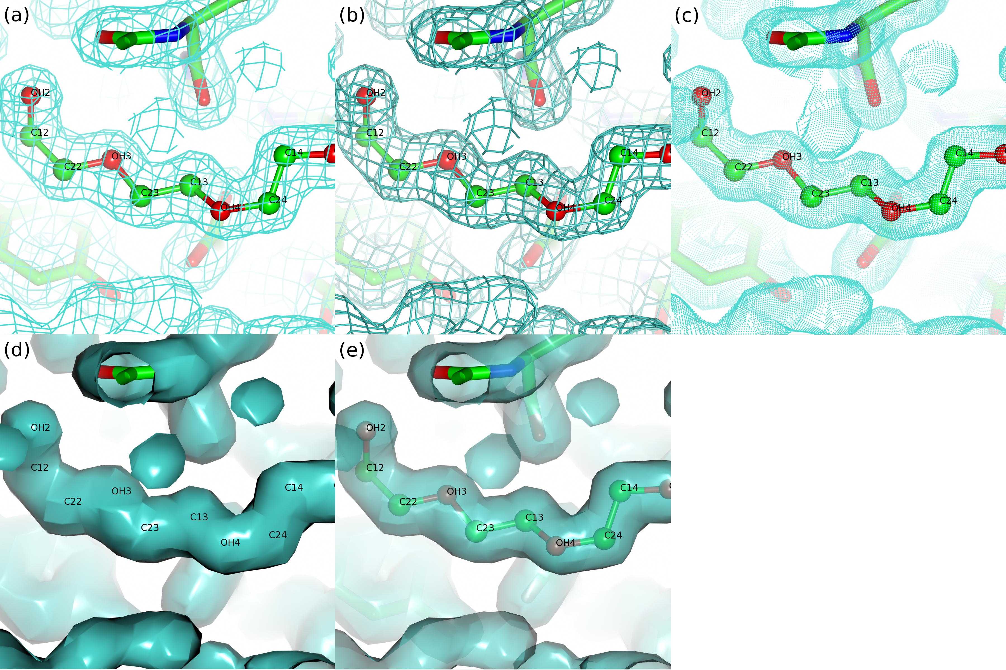

Slide 27
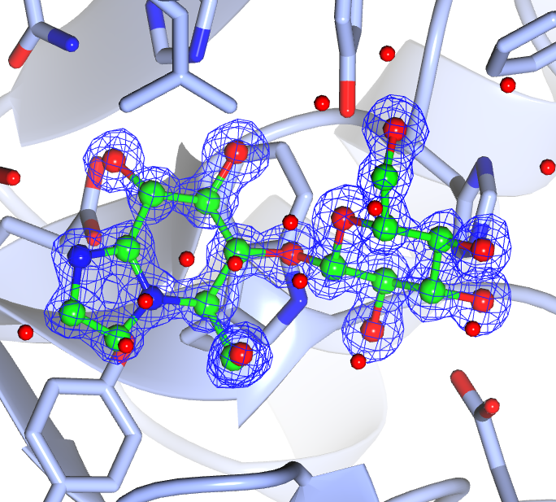

Slide 28
Electron Microscopy Maps
CCP4MG can cope with 1000 angstrom sized maps.
Maps from electron microscopy do not recalculate when moving view like X-ray maps. Massive speed improvement.
Colour by distance from centre of map option – nice for virus maps.

Slide 29
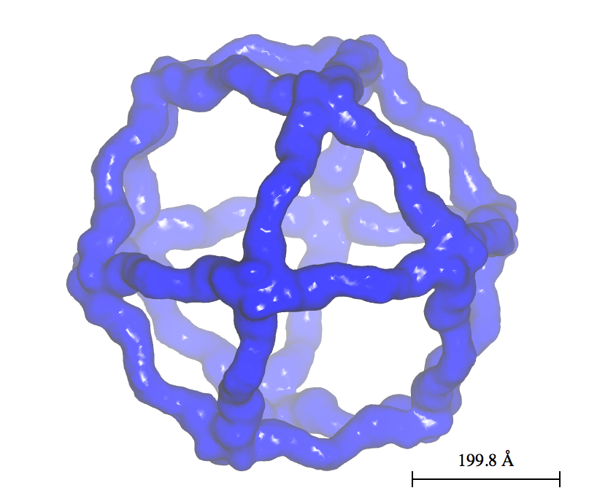
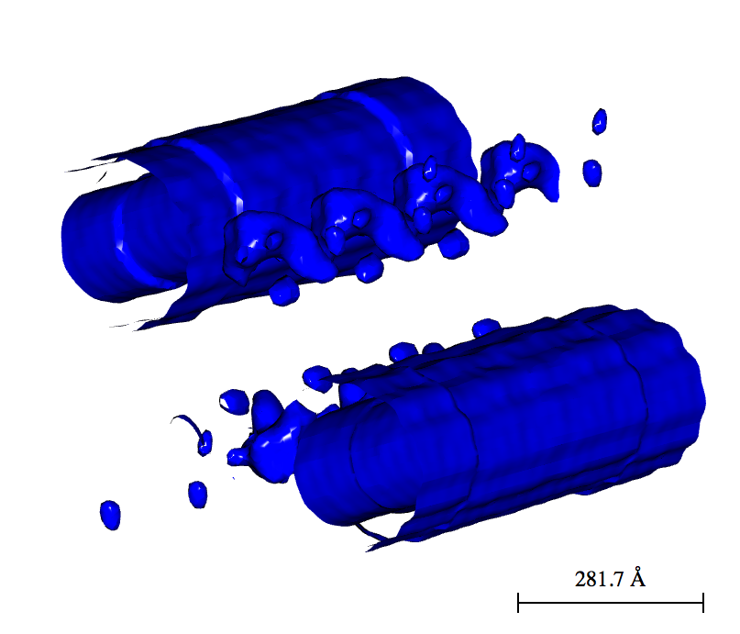
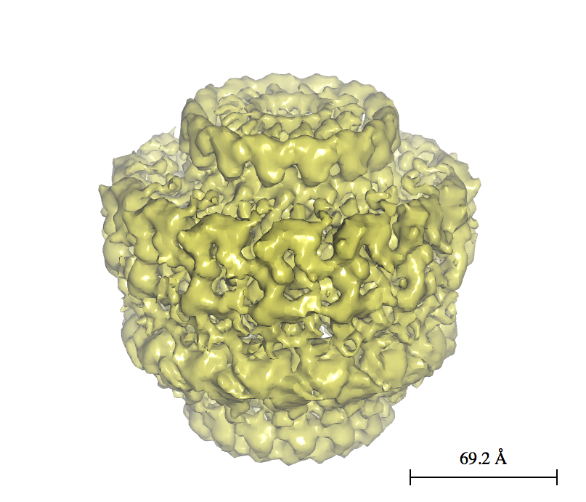
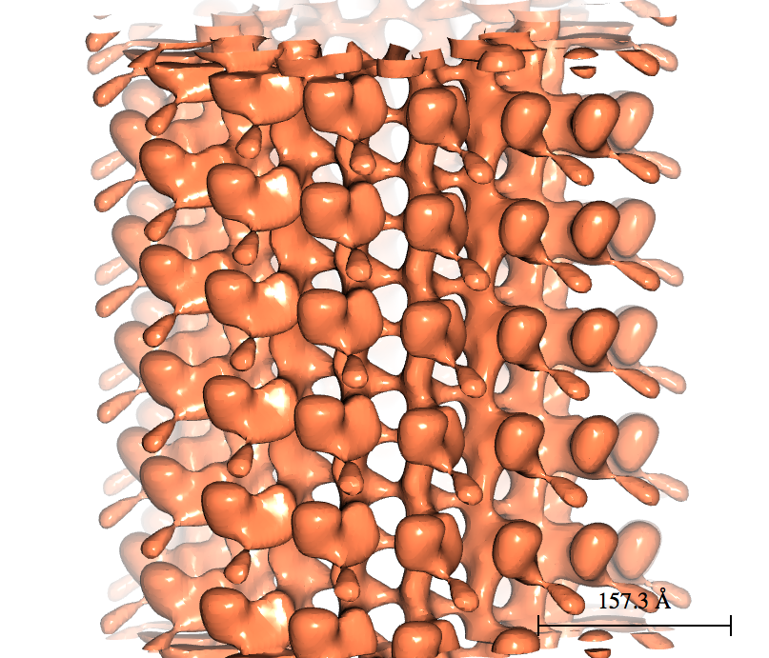
EMD 5524
EMD 5622
EMD 2232
EMD 5416

Slide 30
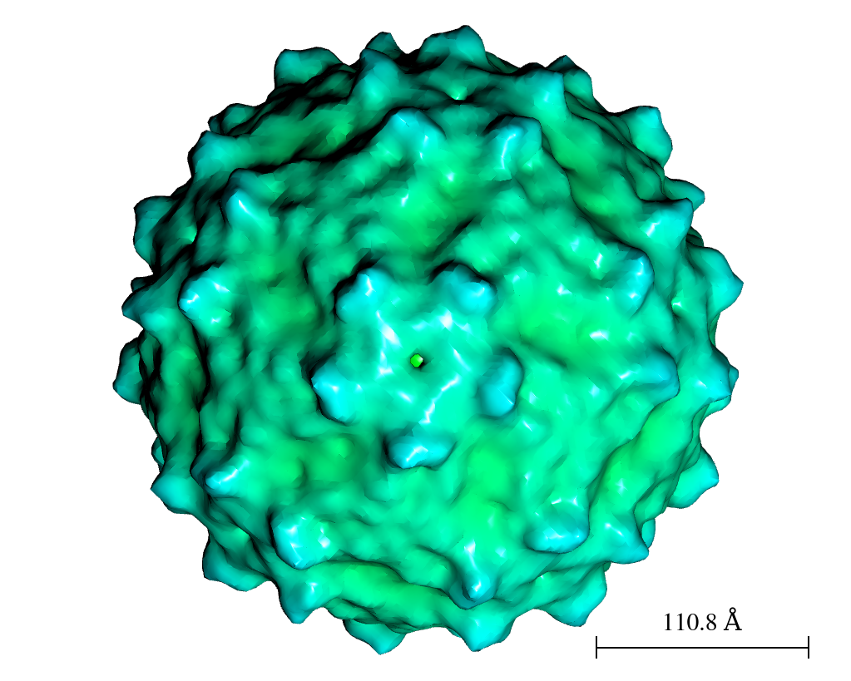
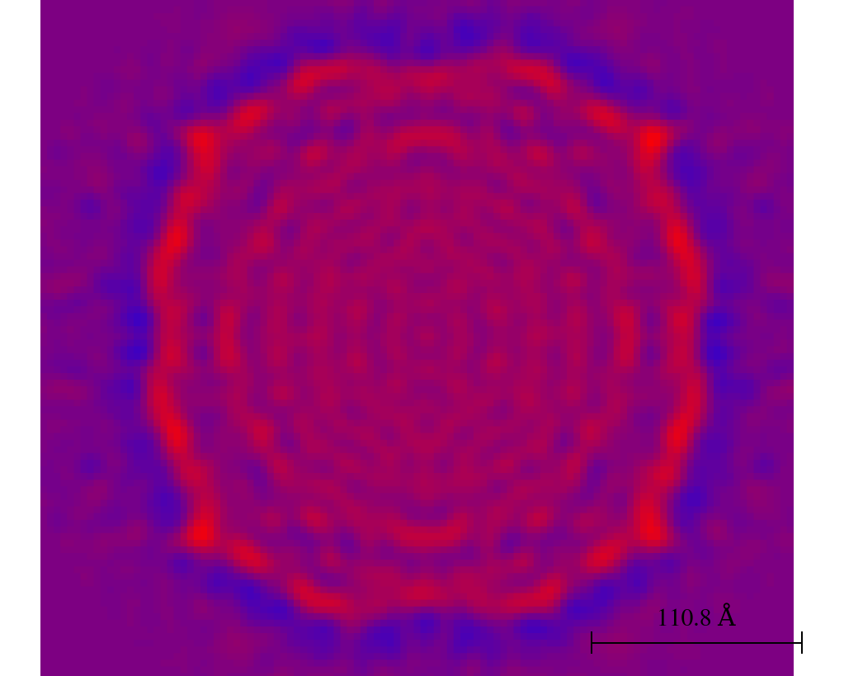
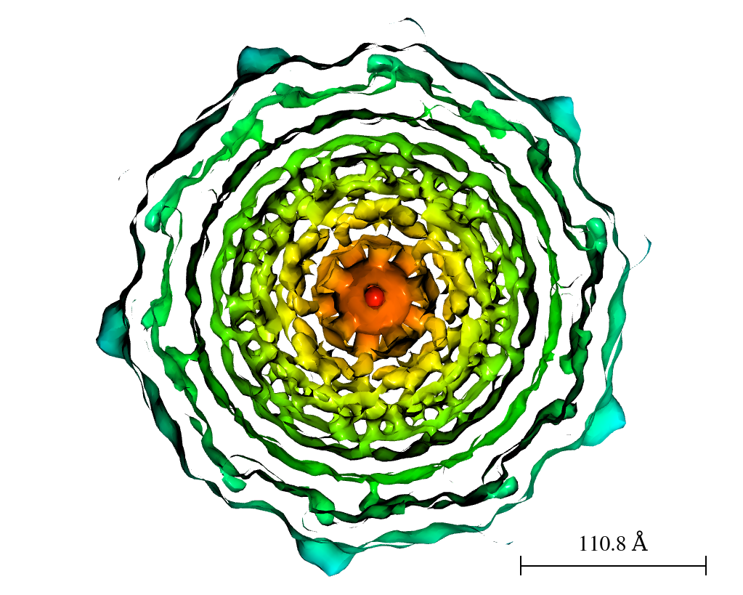
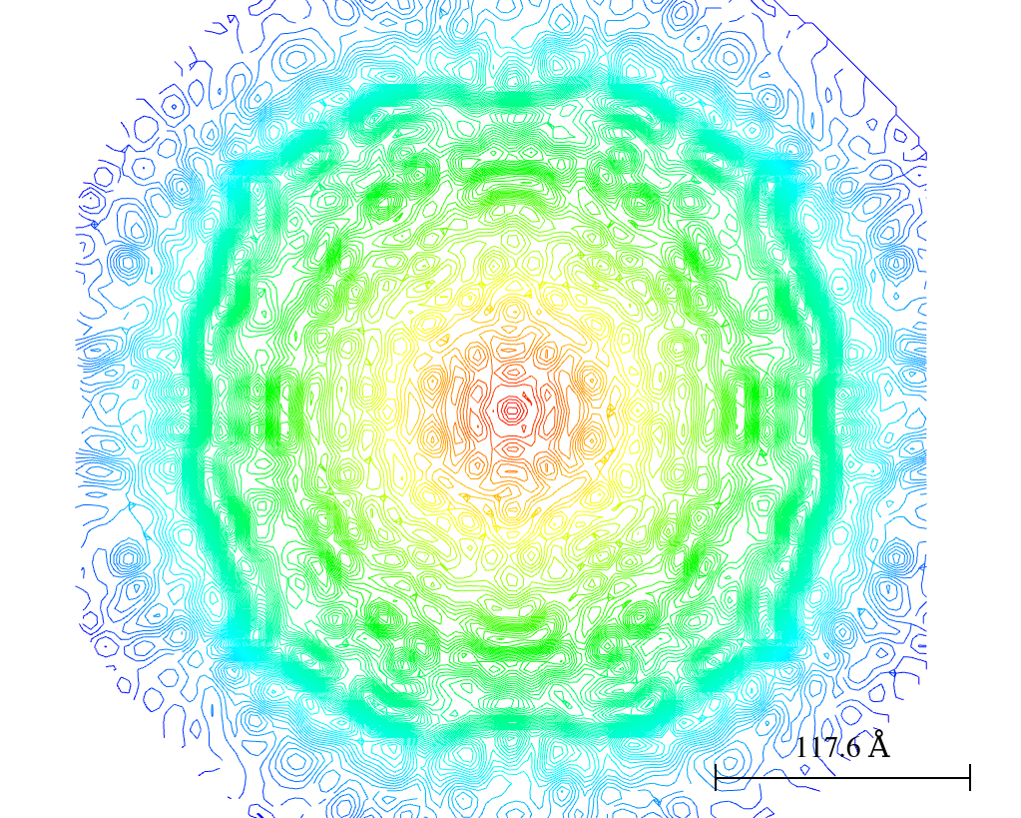
EMD 5580

Slide 31
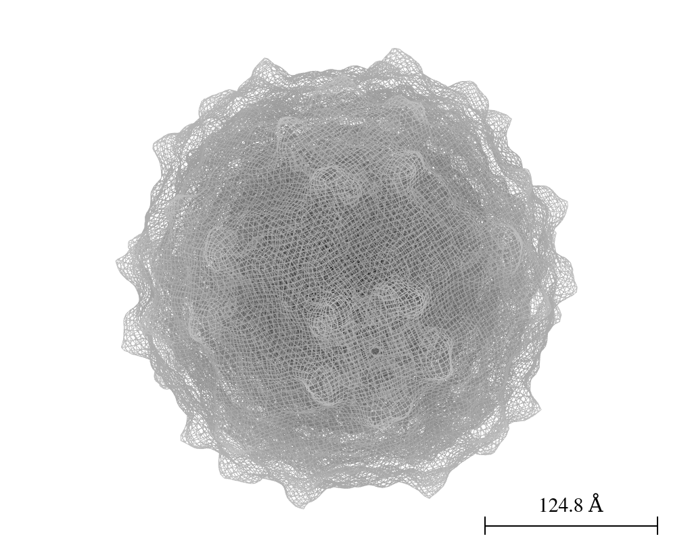
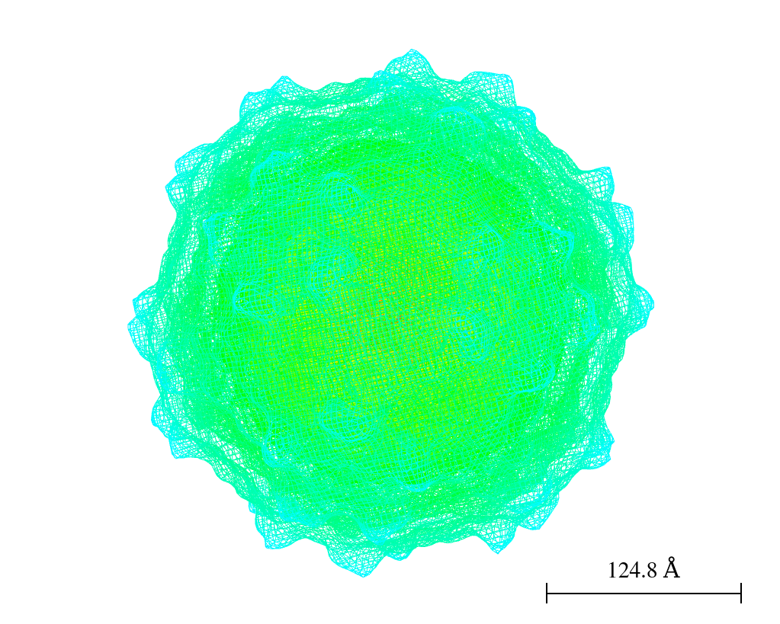
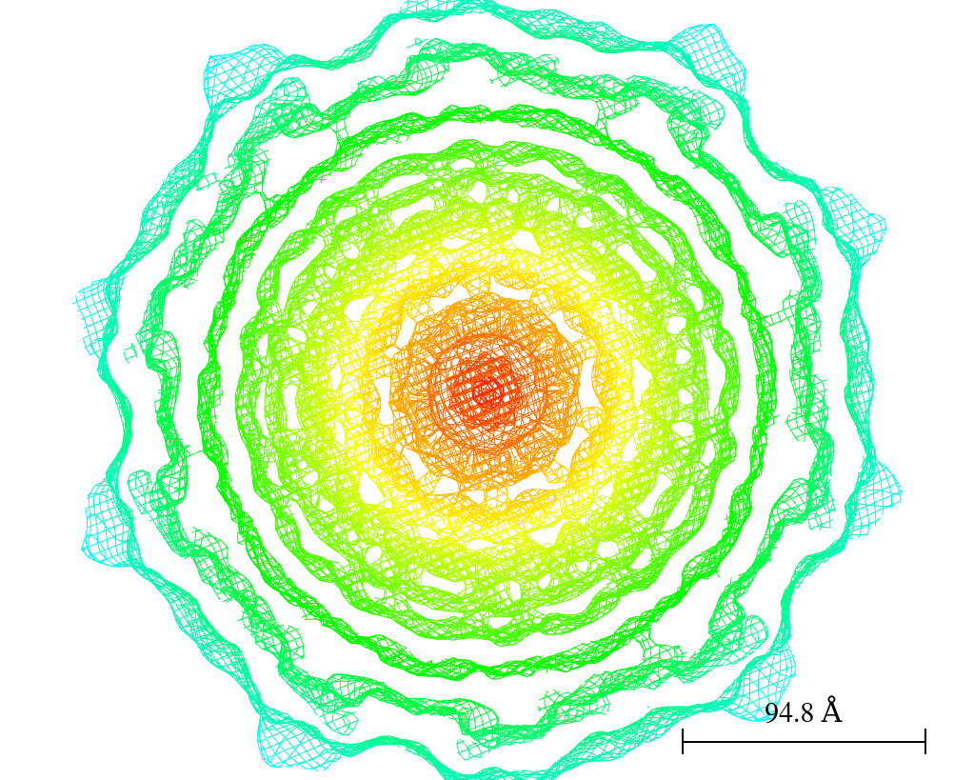
EMD 5580

Slide 32
Symmetry
Two ways:
  Fast: Apply symmetry operations to objects which are drawn. “Continuous”, “About a point”, “unit cell”.
  Not so fast: Create new display objects which can then have style, selections, etc. edited.

Slide 33
Biological Assemblies
CCP4MG can parse the biological assembly information contained in PDB files.
  Set of transformation matrices that create symmetry mates of model information to create a complete assembly.

Slide 34
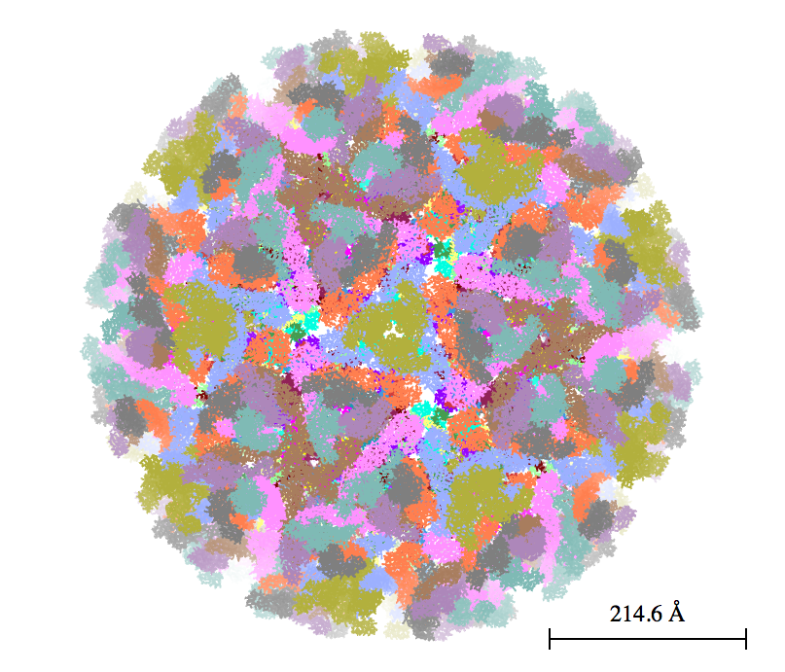
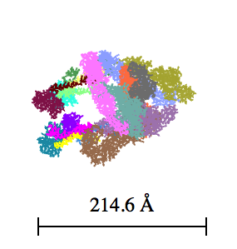
PDB 3j2w

Slide 35
Shadows and Occlusion
“Real-time” shadows, i.e. active all time in graphics window, not just when you “Render”.
Occlusion is darkening of buried bits which are not exposed to as much light as exterior parts of macromolecules. Also a “real-time” effect.

Slide 36
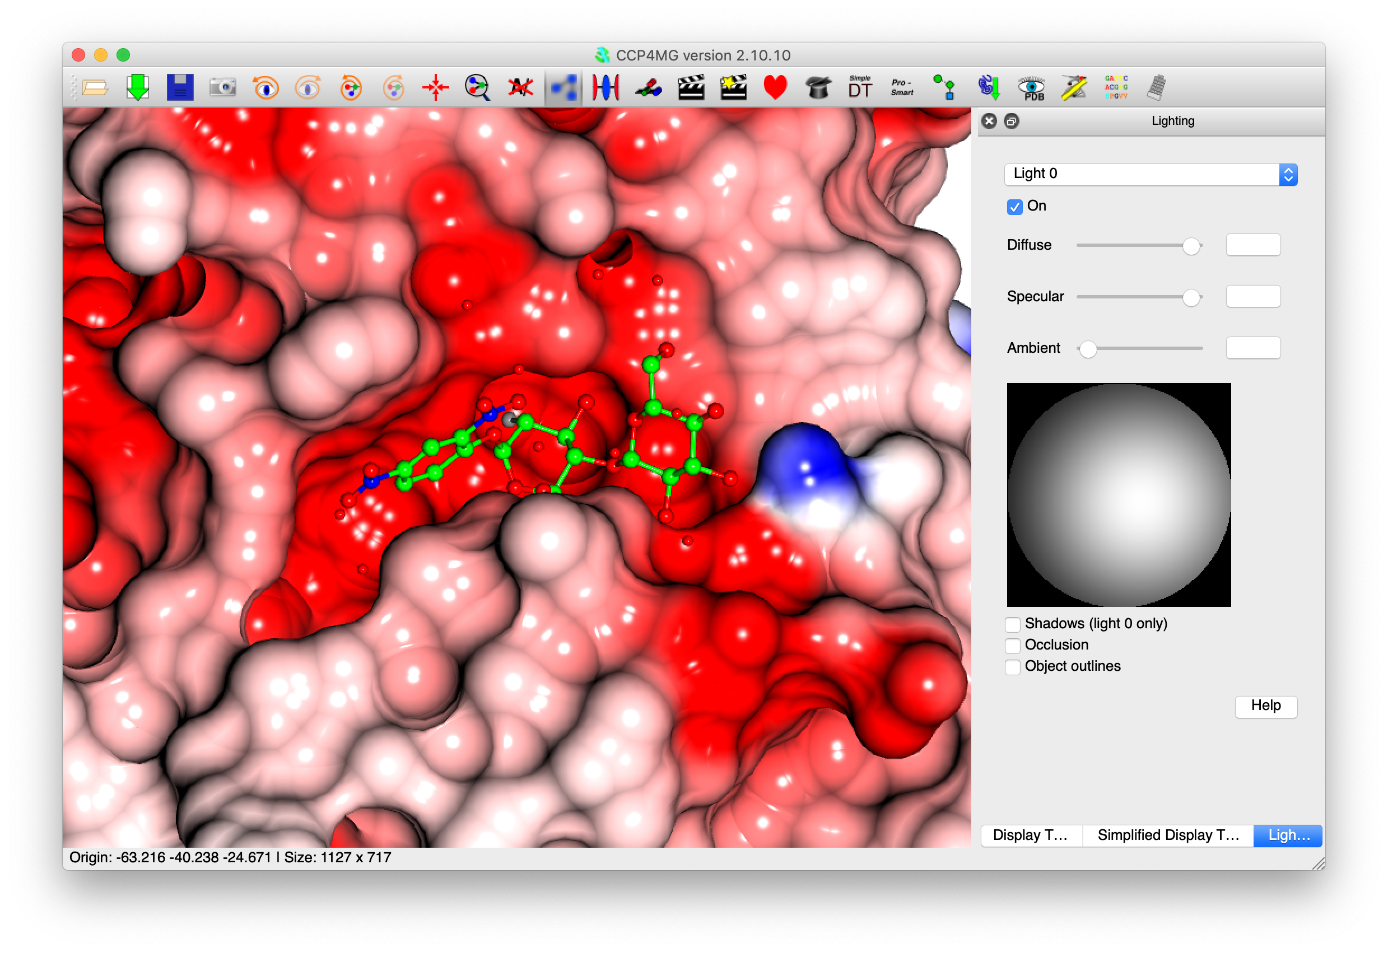

Slide 37
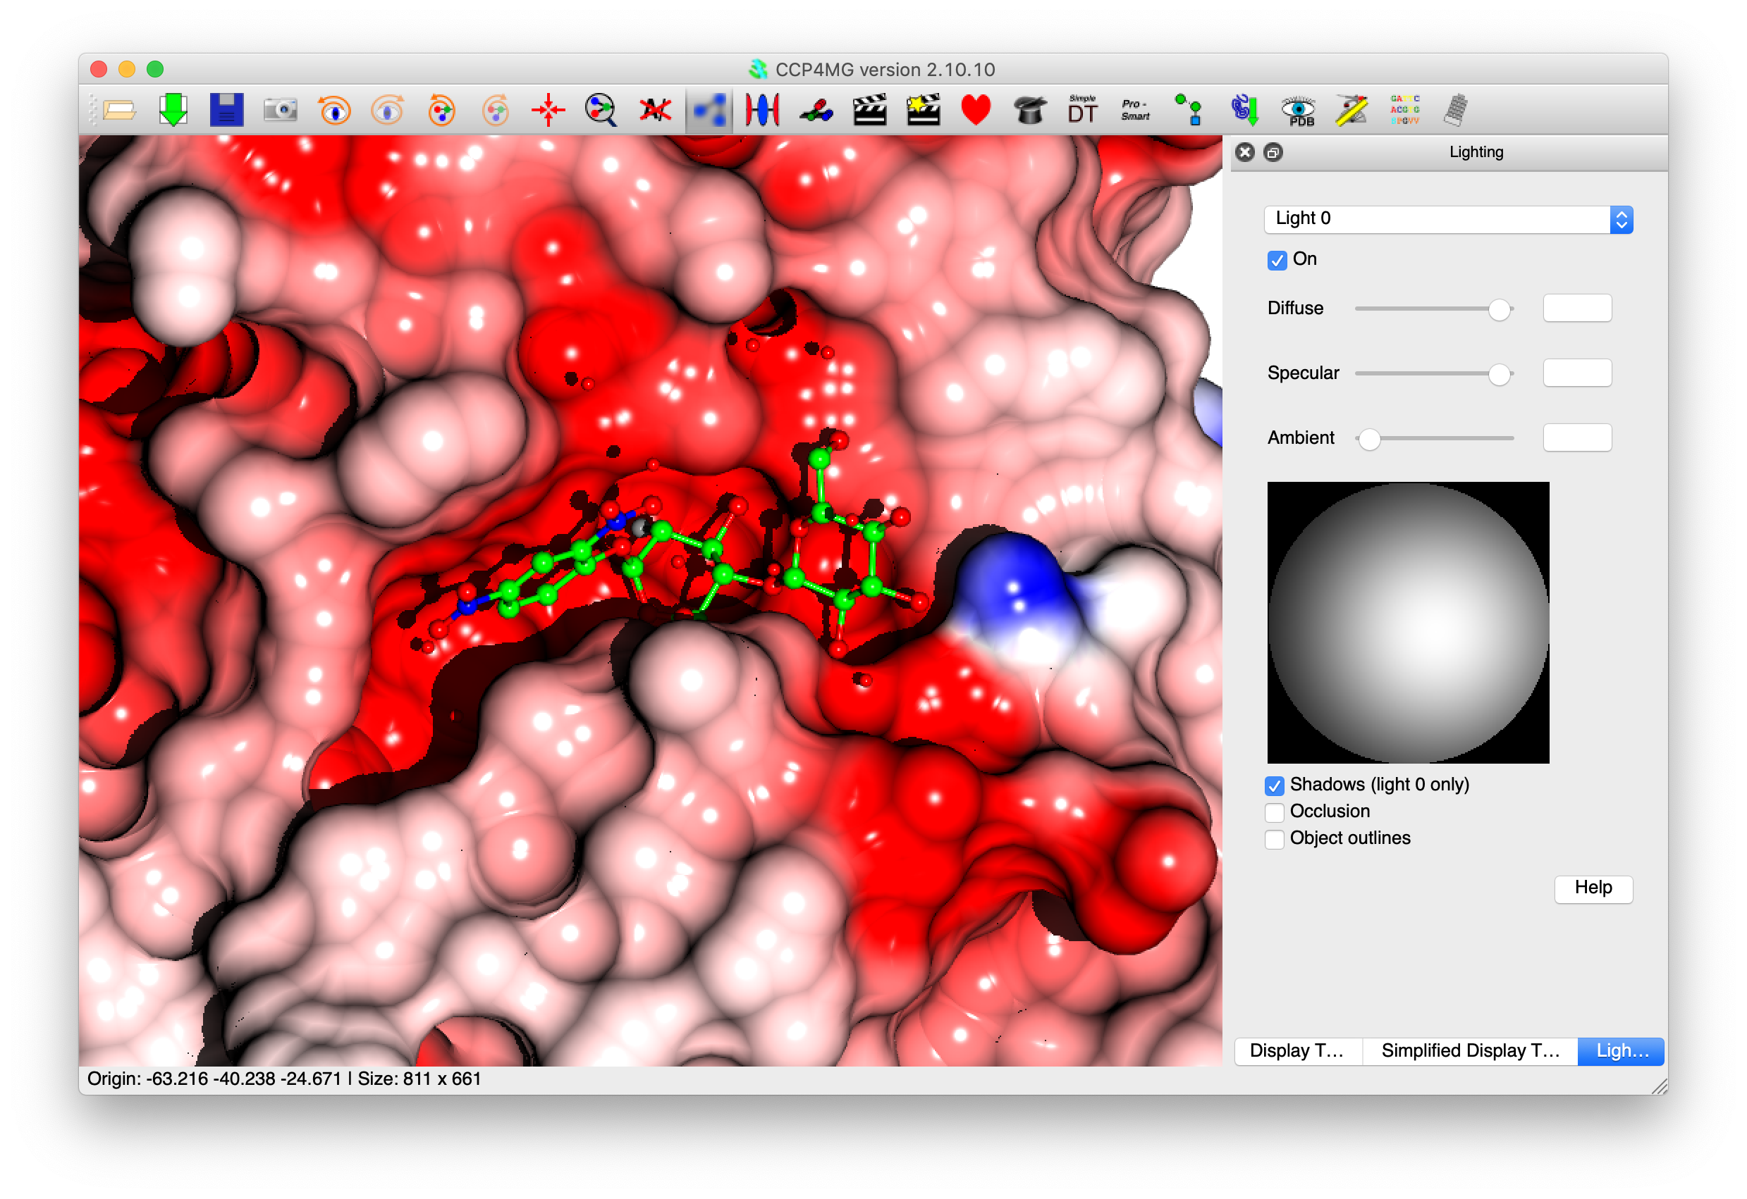

Slide 38
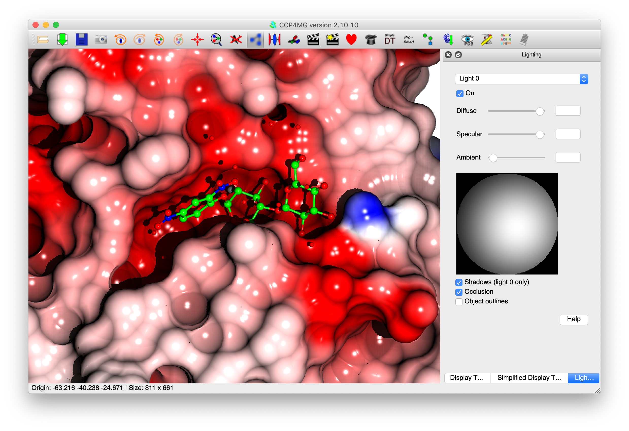

Slide 39
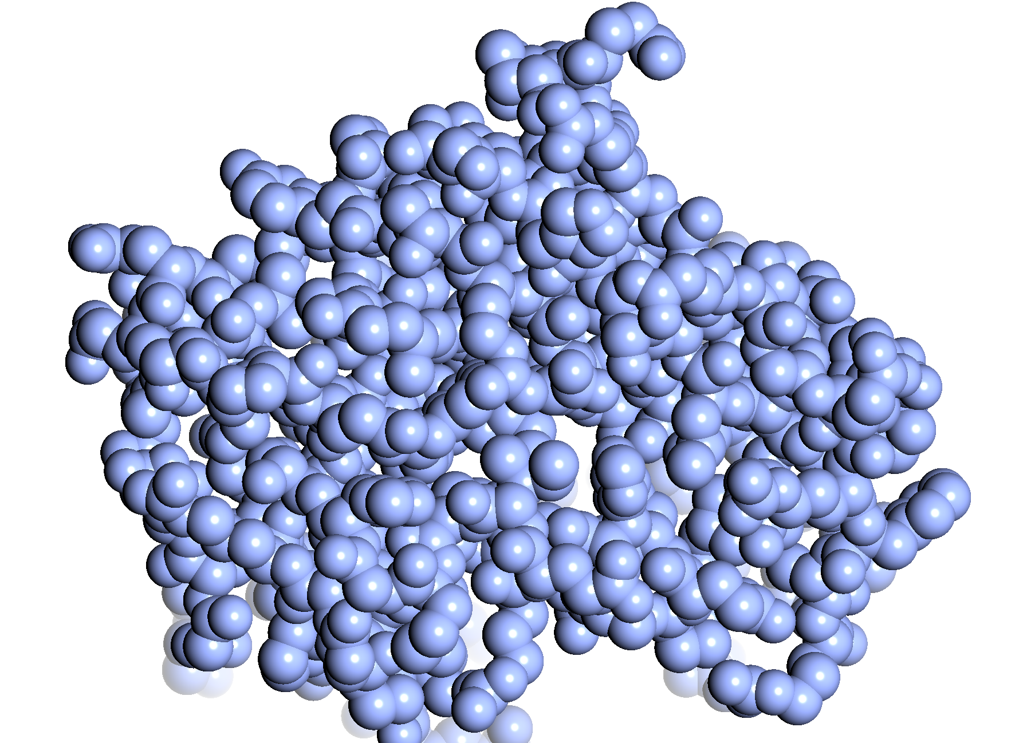
Normal lighting

Slide 40
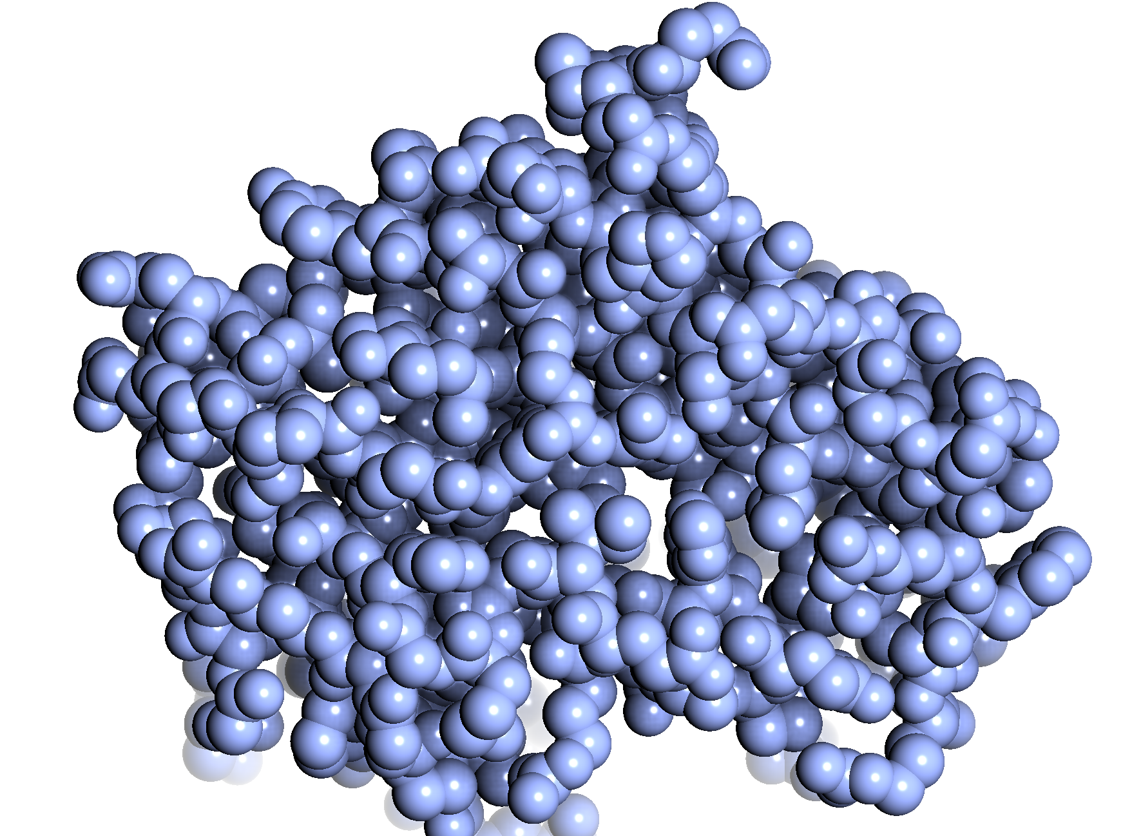
Occluded lighting

Slide 41
“Perfect spheres”
“Ray-traced”, perfectly spherical spheres in main graphics window.
1 quadrilateral per sphere compared with traditional method with 81 (smooth) or 324 (deluxe) quads. So use much less memory. Further memory reductions are also possible with newer graphics cards, but this is not yet done.
Faster when zoomed out, same speed (possibly slower) when zoomed in. Work needed to claw back some optimisations. (Could be less of a problem if e.g. Apple's drivers used more hardware features ….)

Slide 42

Traditional spheres:
81 quads per sphere

Slide 43

Traditional spheres:
324 quads per sphere

Slide 44

“Perfect spheres”:
1 quad per sphere

Slide 45

With shadows
and occlusion.

Slide 46
Other Display Details
All objects
  May be visible/invisible
  “Flash”
  Be transparent with arbitrary opacity
One can have multiple views (e.g. side-by-side stereo)
Hardware/Zalman stereo.
Depth-cueing fog, clipping, background colour and lighting are all user definable
Lots of stuff is highly customizable (Edit->Preferences (Windows/Linux), QtMG->Preferences (Mac))

Slide 47
“Rendering”
CCP4MG has two methods of producing final images:
  Screenshot. A simple dump of the screen pixels is performed. Images may be up to ca. 8000x8000 pixels. On most systems.
  “Rendering”. This uses a Renderman compatible renderer “Pixie”. Some aspects of these images are of much higher quality than the simple screen dump (spheres particularly). Better transparency with more than one transparent object is possible.

Slide 48
Render vs. Screenshot
Real-time shadows and occlusion and “perfect spheres” mean OpenGL is now arguably a better choice for rendering than “Render” module.
Screenshot pros:
  Shadows make “Render” slow, but bearable.
  Ambient occlusion makes “Render” really, really slow.
  Darkness of OpenGL shadows could be changeable, “Render” ones are simply very black.
  Much faster. 1DF7 ribbon + sphere ligand + shadow + 2x supersampling: 84s “Render”, 3s screenshot.
Screenshot cons:
  OpenGL shadows can be too soft and fuzzy with large structure.
  “Perfect spheres” are not anti-aliased (smoothed) - so not so perfect!). This can be worked around (now) by taking screenshot at larger size (2x, 4x, etc.), though this ought to be automatic.
  Render handles multiple transparent objects properly. (Work in progress to make OpenGL renderer cope with multiple objects.)
  Screenshots do not work with all graphics drivers

Slide 49
“Batch” rendering
Images may be rendered from command line or from scripts without starting up the main program.
ccp4mg -norestore -picture mypic.mgpic.py -R test.png -RO '{"size":"1600x1600","smoothribbons":"1", "raytrace":"1"}' -quit
The file mypic.mpic.py is a file containing a scene description: lists of data files, representations, view, etc.

Slide 50

Distances and angles
Double-click on one atom then another to measure bonds.
Shift-double click on other atoms will measure angles.
Results appear in table below and in graphics window.

Slide 51

On screen text and images

Slide 52
Online data access
Download PDB files (PDB)
Download MTZ files (PDB)
Download Structure Factors (PDB)
Download EM map files (EMDB)
Download PDB-REDO PDB/MTZ
Blast searches (EBI)

Slide 53



Slide 54
Structure Superposition
CCP4MG has several methods of structure superposition:
  SSM - This is the default method. It is the simplest to use and usually gives excellent results. The method attempts to match secondary structure elements in different coordinate sets.
  Gesamt – a more general method which matches fragments which need not be defined by secondary structure elements.
  Close Residues -This method is useful for performing locally optimised superposition after a global superposition by SSM/gesamt.
  User-defined. This is the most flexible, but least easy to use: the user can specify in many ways the atoms to superpose.

Slide 55
Sequence Viewer
Align sequences using muscle (a free multiple-alignment program) or ClustalW.
Continuous (consurf style) or discrete traffic-light colour by conservation.
Colour by secondary structure.
Blastn/blastp interface. Blast results cached between sessions. Blast normally run remotely (EBI) with explicit user permission, but can also use local blast installation.
Save sequence as PDF/bitmap/plain text.
Click, shift-click, ctrl-click, etc. on residues in sequence to display atoms in the mail window.

Slide 56


Slide 57
Saccharide display (Glycoblocks)
Visual style useful for comparing positions/orientations of (poly-)sacchardides in multiple coordinate files in a way which is easy to visualize.
3D equivalent of conventional 2D glycosolation trees with “standard” symbols and colours representing the different sugar types.
Would be nice to do the same in 3D using same symbols.
Work done with Jon Agirre, University of York.

Slide 58

Saccharide display

Slide 59

Saccharide display

Slide 60

Saccharide display

Slide 61

Saccharide display
Hydrogen bonds to multiple domains.
GlcNAc to TRP stacking interaction.
5FJJ, Agirre et. al., Acta Crystallogr D Struct Biol 72, 254-265 (2016)

Slide 62

Glycan Viewer
2D representations generated by Privateer,
Jon Agirre and Kevin Cowtan.

Slide 63


CCP4MG / MrBUMP

Slide 64
MrBUMP
MrBUMP is an automated scheme for Molecular Replacement. Given a target sequence and experimental structure factors, it will search for homologous structures, create a set of suitable search models from the template structures, do molecular replacement, and test the solutions with some rounds of restrained refinement.
A component of the CCP4 suite of programs.
MrBUMP: an automated pipeline for molecular replacement, Keegan, RM and Winn, MD, Acta Crystallogr. D Biol Crystallogr. 2008; 64, pp 119-124

Slide 65
CCP4MG and MrBUMP
Goal is to provide i2 users with a graphical driven interface to the model search and preparation steps for molecular replacement in MrBUMP. The intention is to derive a graphically-informed single “best” search model for passing back to i2 and the Phaser/Molrep interfaces

Slide 66
CCP4MG and MrBUMP
CCP4MG uses initial steps of the MrBUMP to interactively edit molecular replacement models.
Scheme:
  MrBUMP is sent a sequence from CCP4MG
  uses the phmmer tool to search for homologous structures with a maximum similarity between them of 100%, 95%, 90%, 70% or 50%.
  select just the relevant chains from the structures.
  prune side chains.
  structurally align the pruned structures (gesamt).
  CCP4MG loads the structures and shows a MrBump results window.
Notes:
Work done in collaboration with Ronan.

Slide 67
CCP4MG and MrBUMP
Then CCP4MG can be used to select subsets of atoms from the newly loaded structures:
  Completely hide some structures.
  Select e.g. just alpha-helices
  Prune terminating loops.
  Whatever … (including “gesamt variance slider”).
And then everything visible can be saved into one ensemble coordinate file for use in a molecular replacement calculation.

Slide 68


Slide 69


Slide 70

“Variance slider”

Slide 71


Slide 72
Other details
Only final ensemble (or individual structures) are saved to i2 database. All MrBUMP results and model are save in ~/.CCP4MG/mrbump_results.
Results from previous jobs can be loaded in later sessions without having to rerun the MrBUMP search.
Results can be deleted when no longer of interest.

Slide 73
Movies
Movies are creates by defining a series of “key frames” and then (optionally) interpolating between them.
Key frames may also define simple transformations (rock, roll, etc.)
Movies can be created either as animated gifs or as MPEG streams.

Slide 74


Slide 75
Getting CCP4MG
Distributed with the CCP4 Suite (except for software to compile movies) :
http://www.ccp4.ac.uk
“Standalone” versions (including movie software ffmpeg):
http://legacy.ccp4.ac.uk/MG
Current version 2.11.0.

Slide 76
Acknowledgements
Programming:
  Liz Potterton
  Eugene Krissenel
  Kevin Cowtan
  Paul Emsley
  Martin Noble
  Jan Gruber
  Bernhard Lohkamp
  Rob Nicholls
  Jon Agirre
  Ronan Keegan
General Help/Support and ideas:
  Keith Wilson
  Phil Evans
  CCP4 staff: Charles Ballard, Marcin Wojdyr, Andrey Lebedev, Ville Uski, David Waterman.
Funding:
  CCP4

